Slide 1
AWS Cloud Devops Udacity Nanodegree 2022-2023
Ahmed alsawi

Slide 2
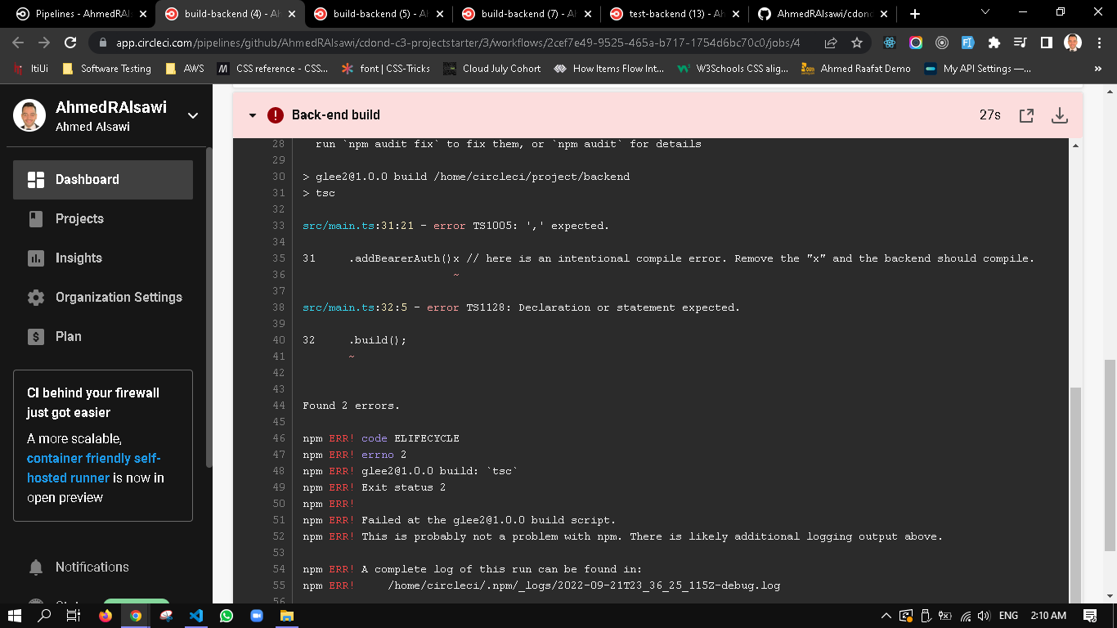
SCREENSHOT01 Example

Slide 3
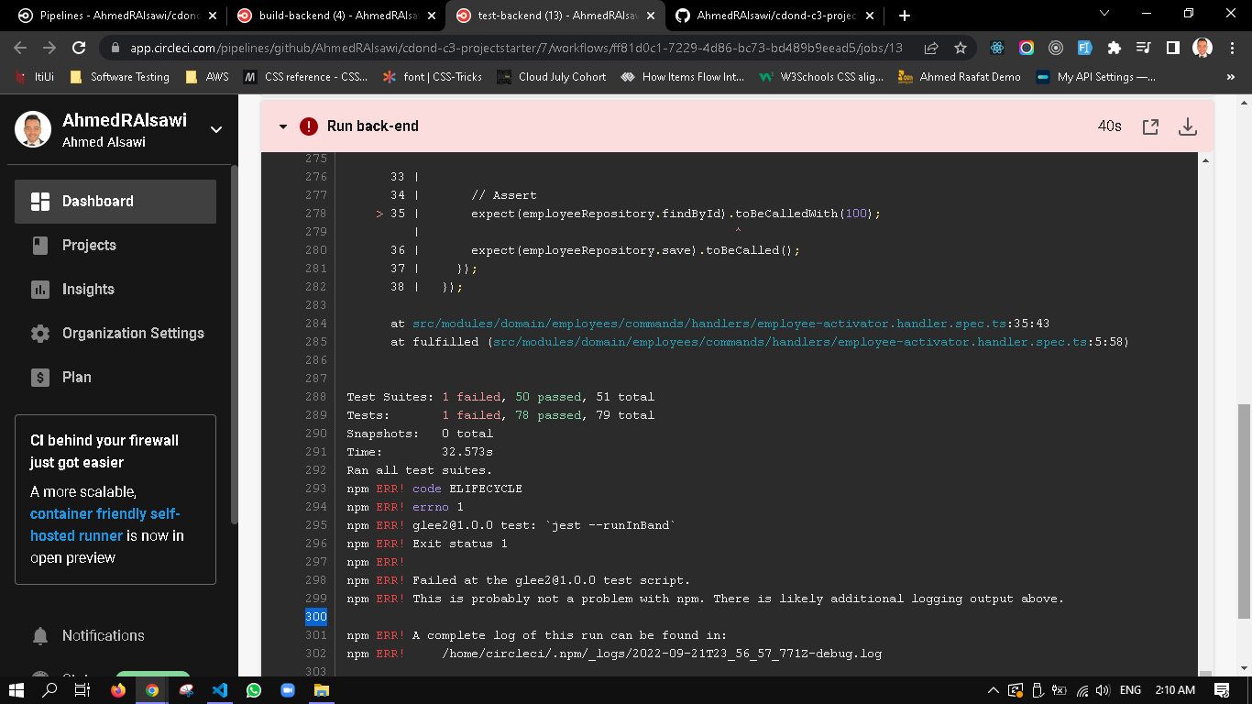
SCREENSHOT02 Example

Slide 4
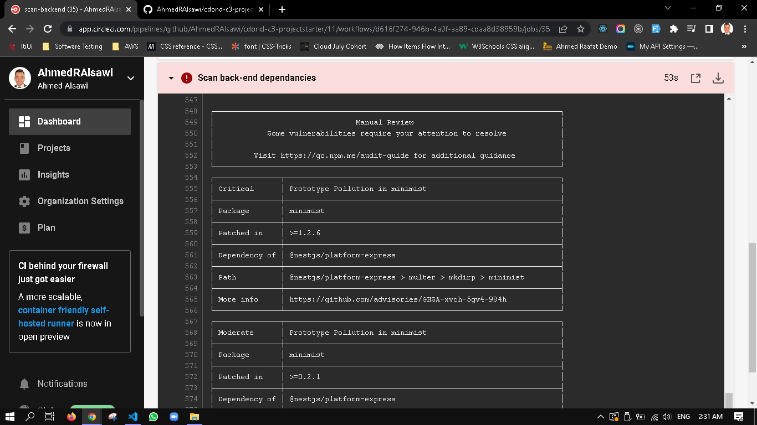
SCREENSHOT03 Example

Slide 5
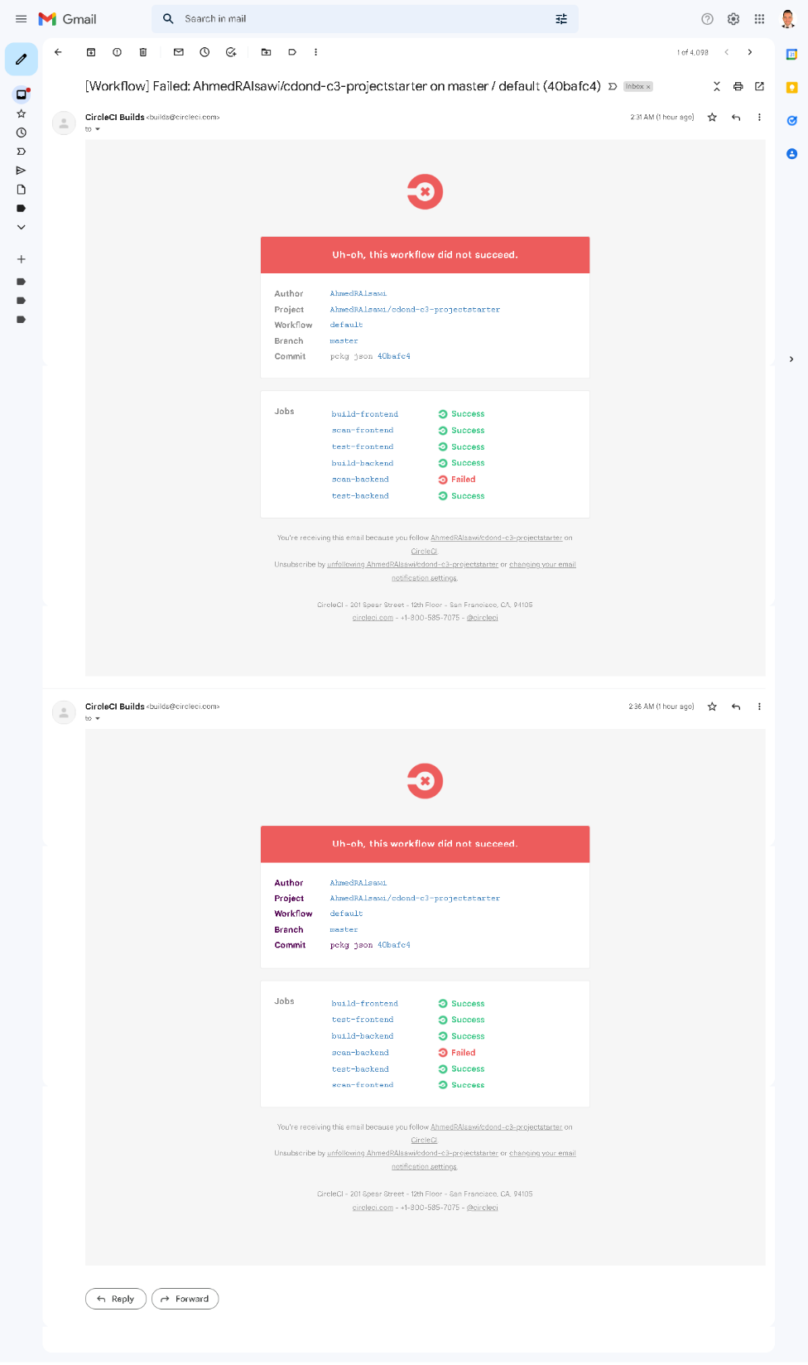
SCREENSHOT04 Example

Slide 6
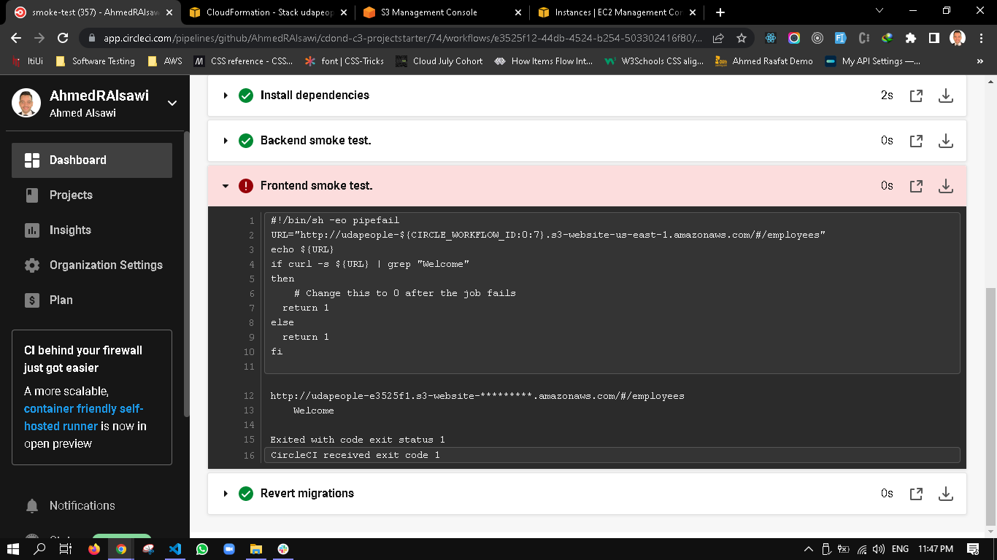
SCREENSHOT06 Example

Slide 7
SCREENSHOT07 Example

Slide 8
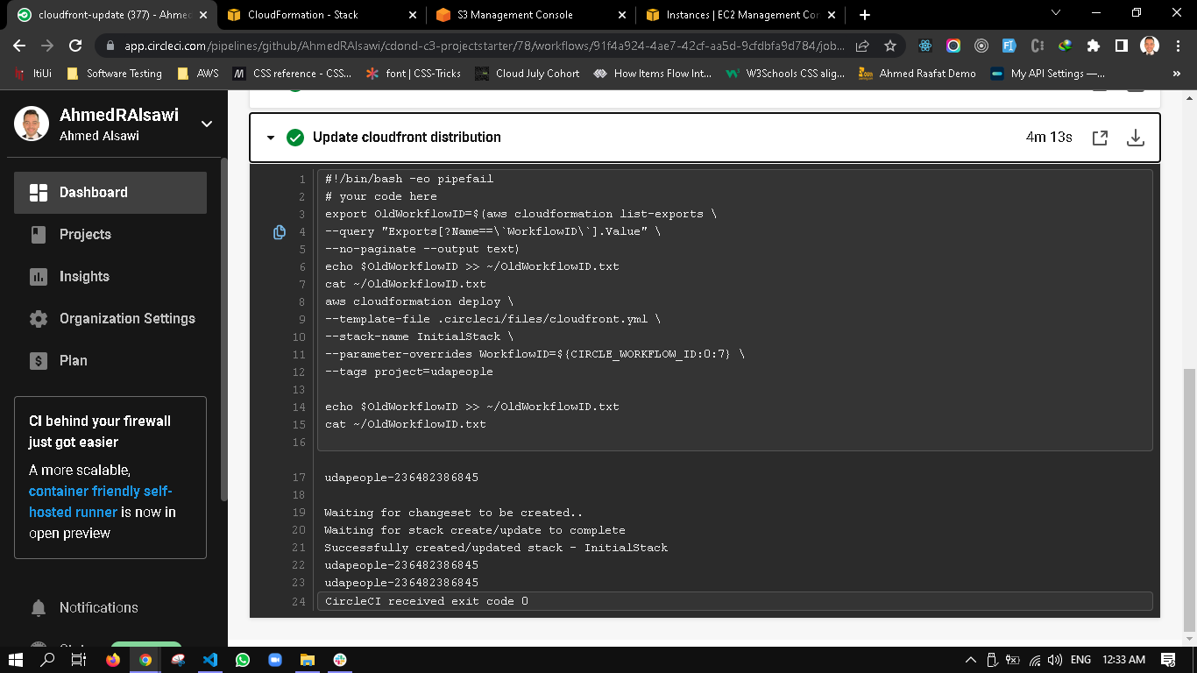
SCREENSHOT08 Example

Slide 9
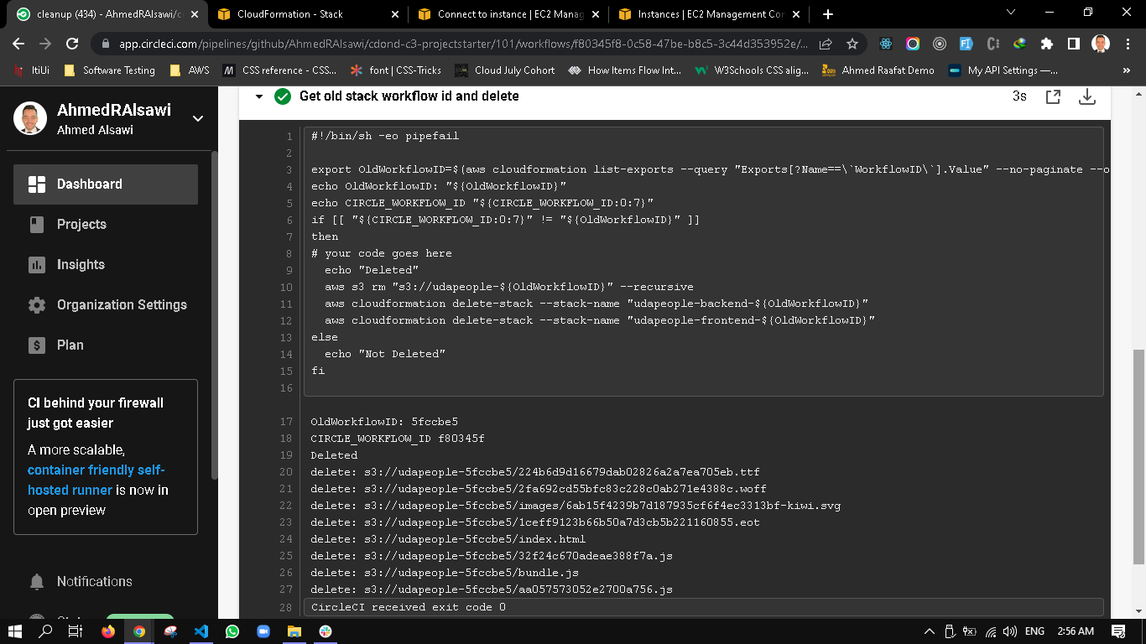
SCREENSHOT09 Example

Slide 10
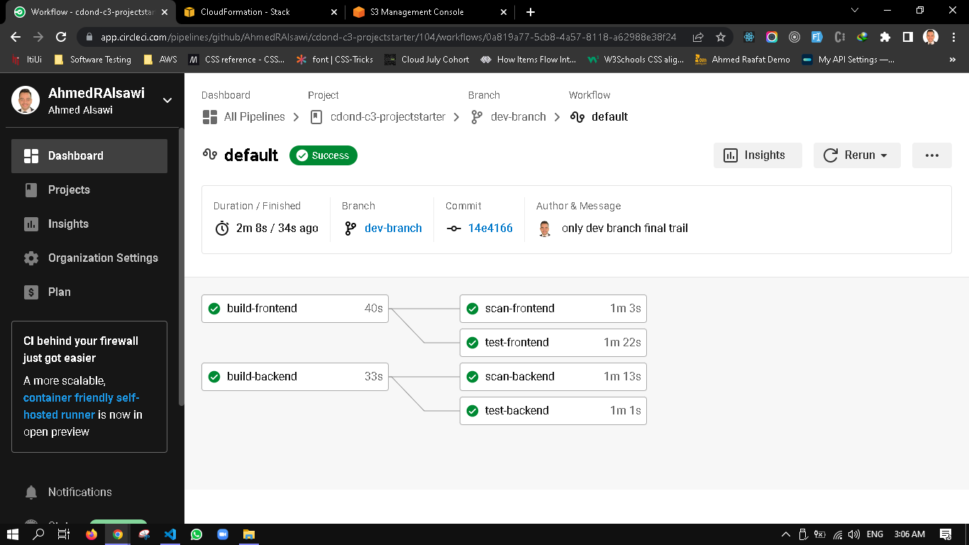
SCREENSHOT10 Example

Slide 11
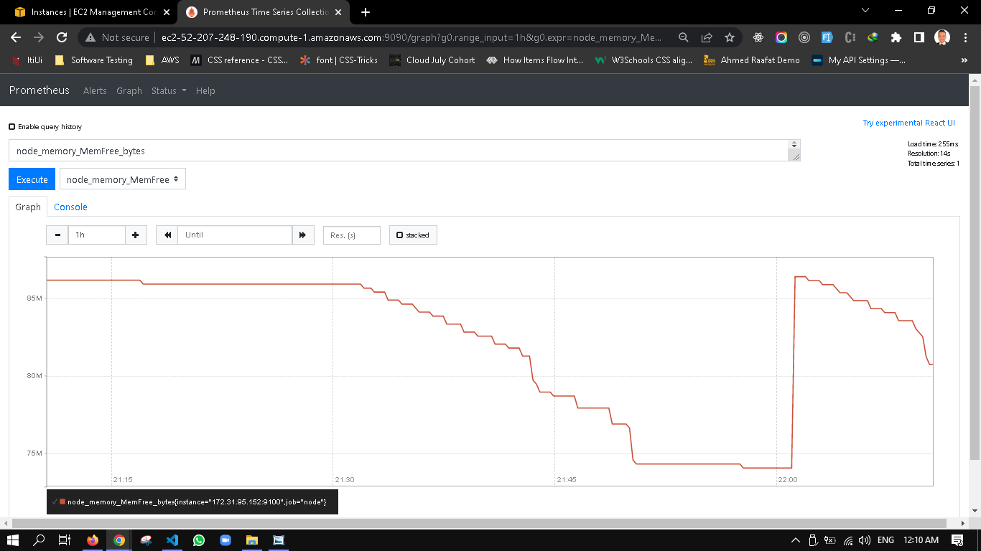
SCREENSHOT11-A Example

Slide 12
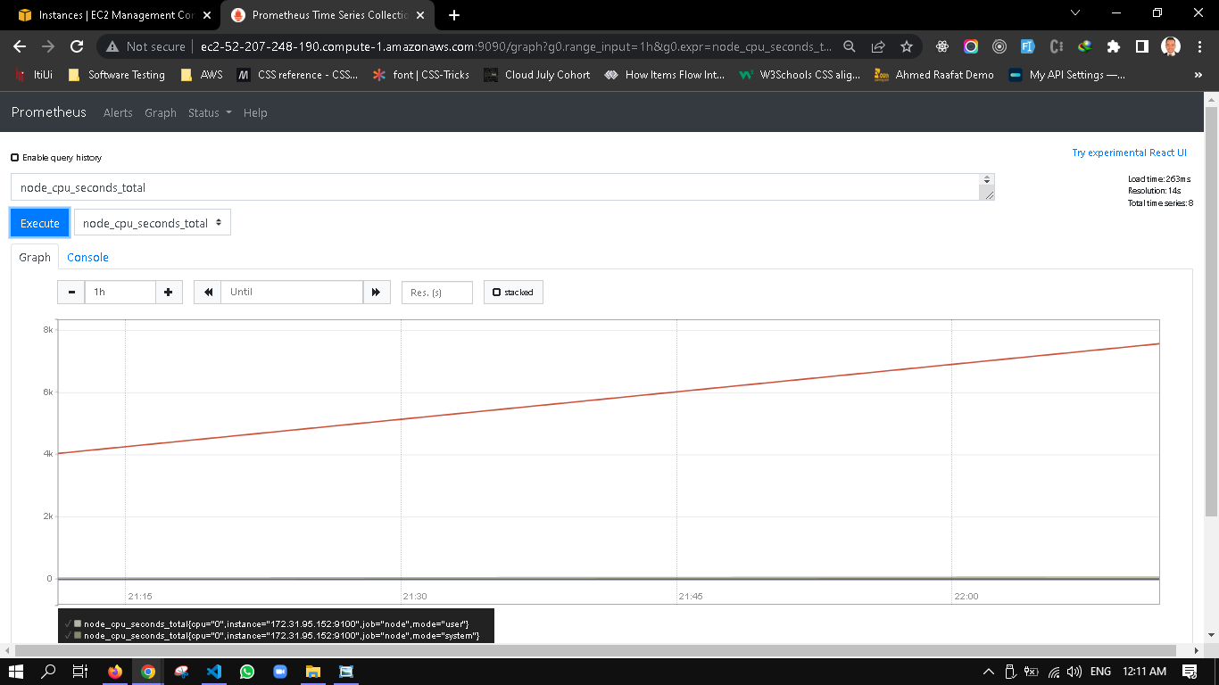
SCREENSHOT11-B Example

Slide 13
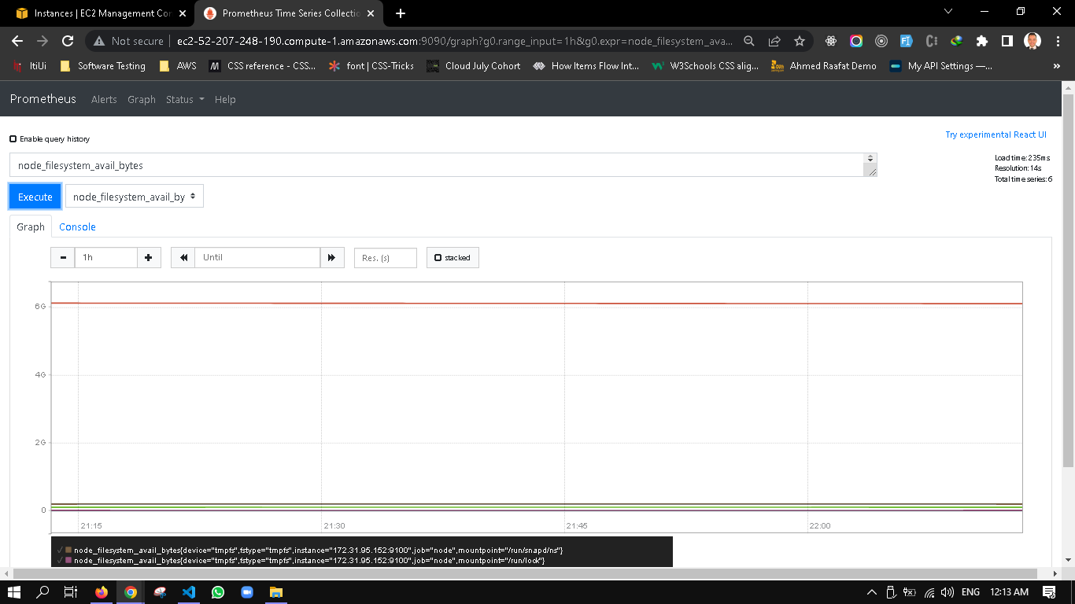
SCREENSHOT11-C Example

Slide 14
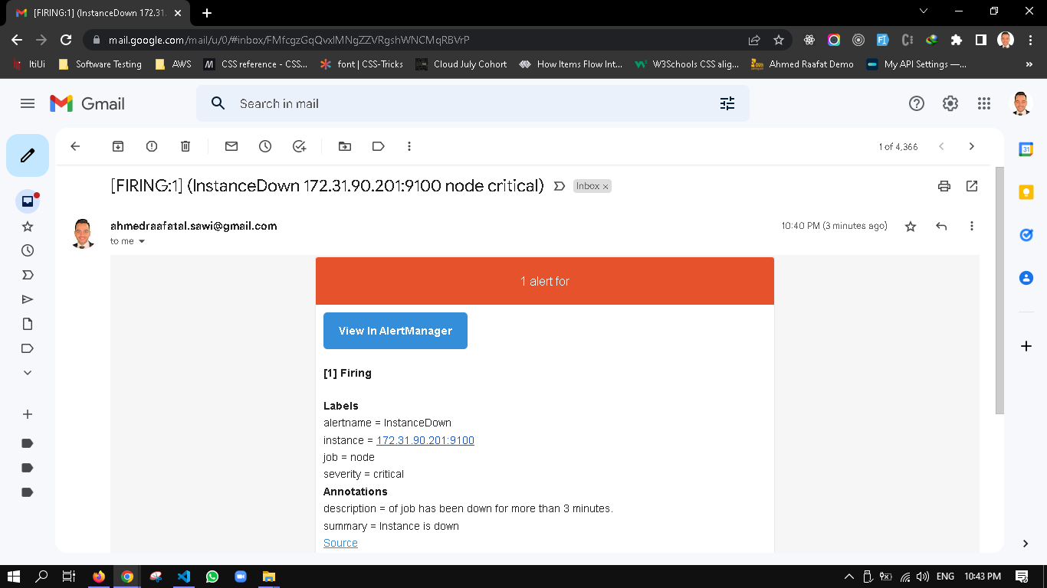
SCREENSHOT12 Example

Slide 15
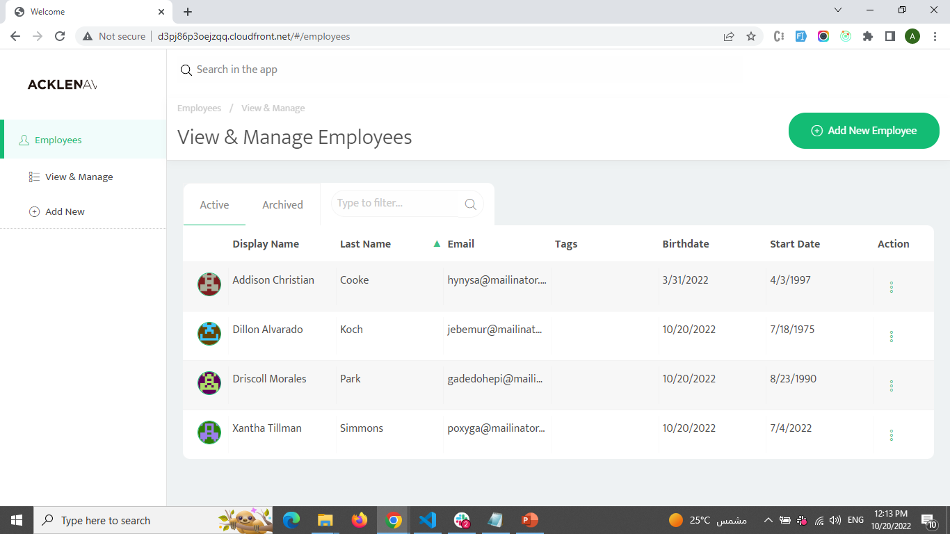
URL01_SCREENSHOT

Slide 16
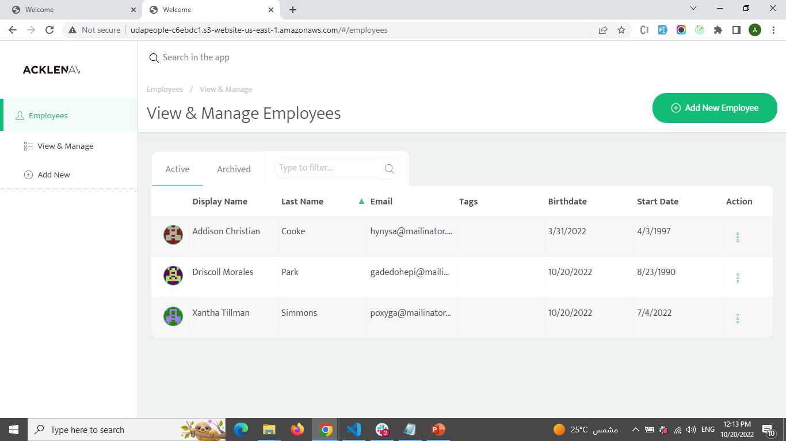
URL02_SCREENSHOT

Slide 17
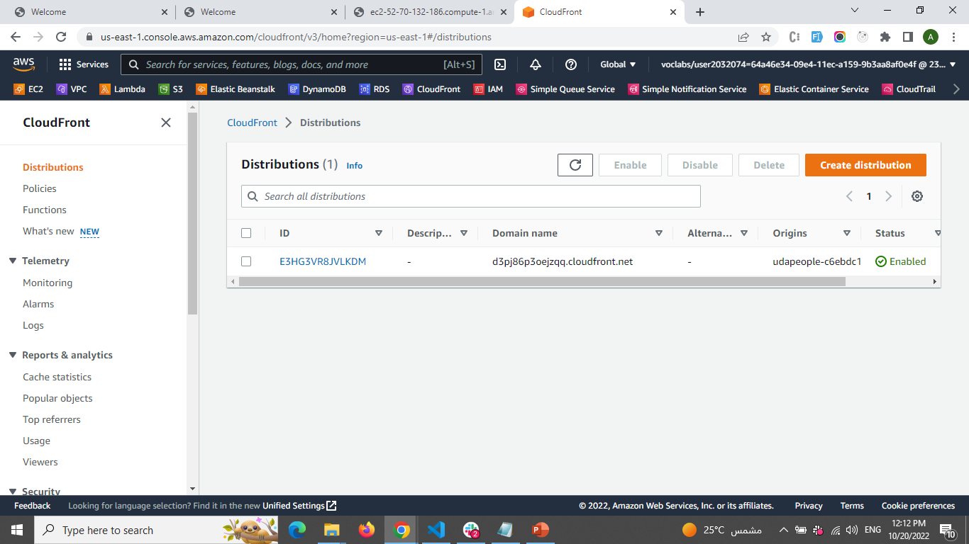
URL03_SCREENSHOT

Slide 18
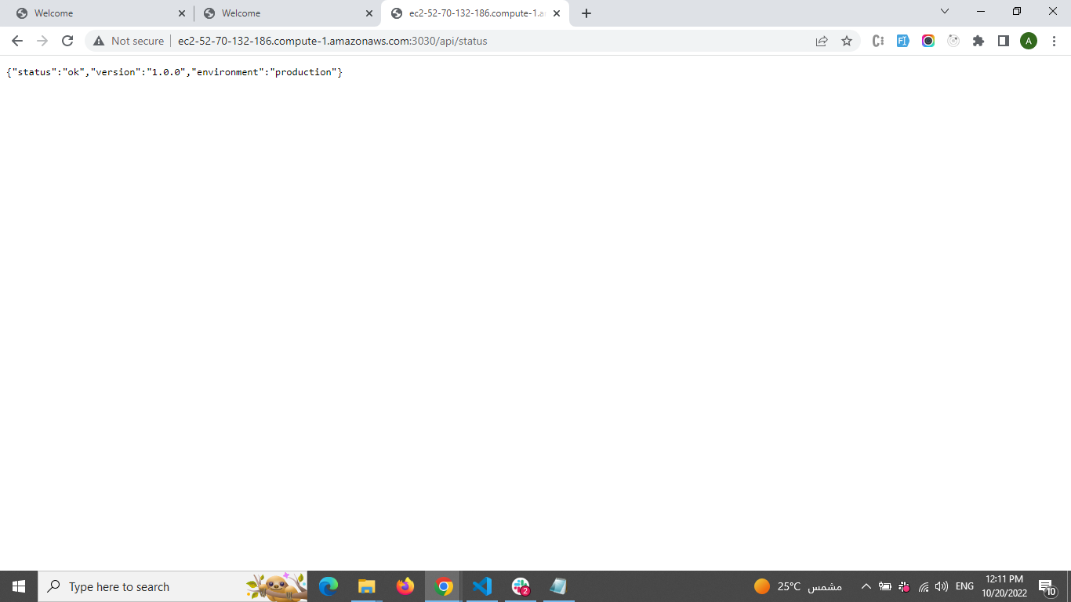
URL04_SCREENSHOT

Slide 19
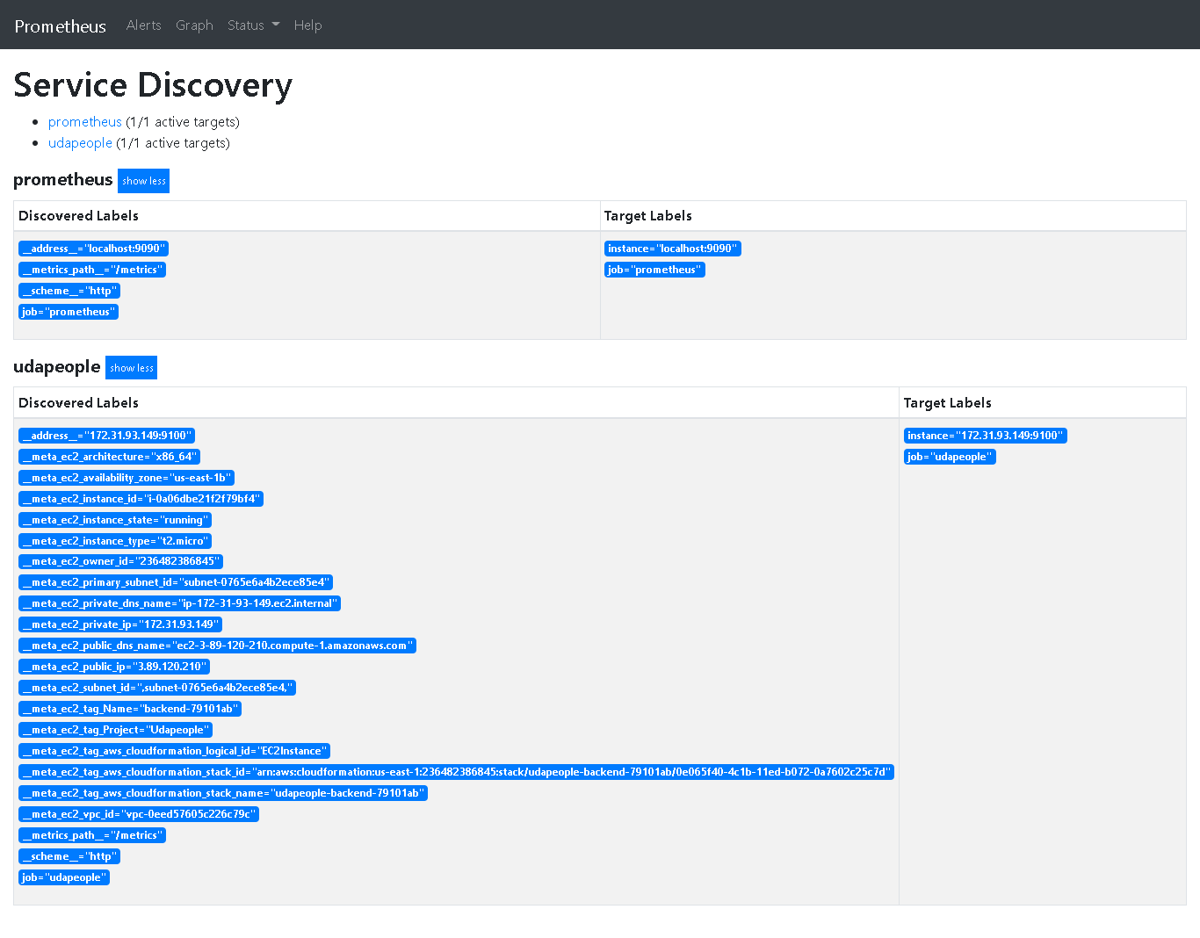
URL05_SCREENSHOT

